Slide 1
ACPS School Board
DART Strategic Brief

Slide 2
2013-14 School / Dept. Improvement Goal
The Department of Accountability, Research, and Technology’s goal for the 2013-2014 school year is to maximize the end-user experience with technology.
  Standard operating procedures will be developed to increase efficiencies and effectiveness.
  Technical staff will engage in professional learning opportunities that enhance customer service skills.
  Technical staff will engage in professional learning opportunities that enhance technical skills.
  End-user satisfaction will be measured and monitored through survey instruments.

Slide 3
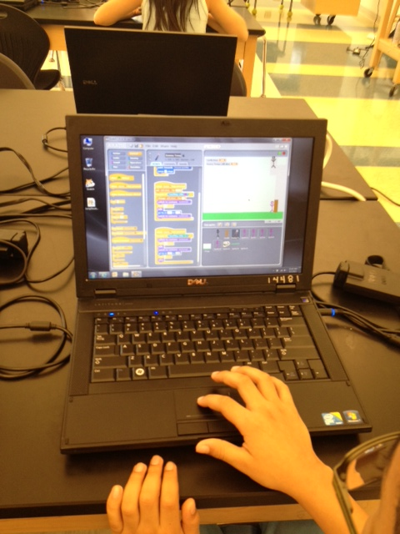
Why This Goal Important
Staff and students rely on the stability of technology for an optimal learning environment.
Time lost to technology-related issues has a major impact on learning.

Slide 4
Current Challenges
Gauging end-user satisfaction of service is difficult because of bias formed by the technology not being available as expected.
Taking time out of the buildings to participate in professional learning opportunities is difficult.

Slide 5
Current Successes
We have been able to drastically reduce the overall number of service tickets compared to past years.
This summer, the department deployed nearly 4000 new devices for students learning based on new standard operating procedures.
Customer service ratings are 80% positive on post-incident surveys.

